Slide 1

Facilitating Effective Tabletop Exercises
Bill Ashland, Synergent Business Continuity

Slide 2

Thursday, October 30, 2025
Facilitating Effective Tabletop Exercises
Topics:
Setting the Table
COVID 19 and the Wonders of PowerPoint
Getting Engaged
Types of Scenarios
It’s a Trap!
Tinkerbelle would be Proud
Mixing Things Up
What’s Next?

Slide 3
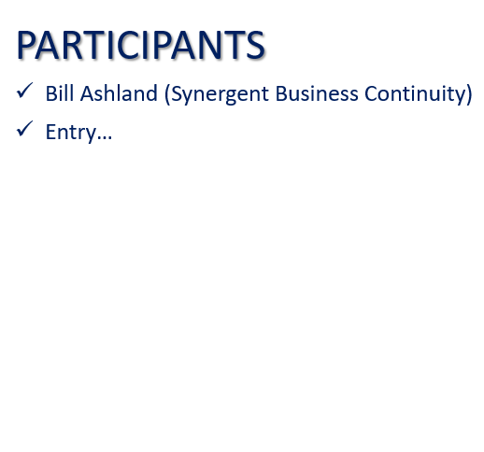
Thursday, October 30, 2025
Facilitating Effective Tabletop Exercises
Setting the Table:
Who is your audience (and how large a group is it?)?
What level of experience do they have?
Is this their first tabletop?
How involved are they in the BCP process?
Is there an area/need that the team is looking to focus on?
How much time do we have?
Is there anything else we should know?

Slide 4

Thursday, October 30, 2025
Facilitating Effective Tabletop Exercises
Covid 19 and the Wonders of PowerPoint:
Pre-COVID, in-person tabletops, Word document report
Challenges –
  Pre-staged presentation deck or paper inserts
  Extensive note taking, often required recruiting a scribe
  Making sense of the notes after the fact
  Having to write a report (in a timely manner)
During COVID, suddenly everything was remote via Teams
Began using PowerPoint in editing mode
  Slides to present scenarios & slides to capture notes in real time
  When done, simply save and have an instant report
  They could then share internally to build awareness/train staff

Slide 5

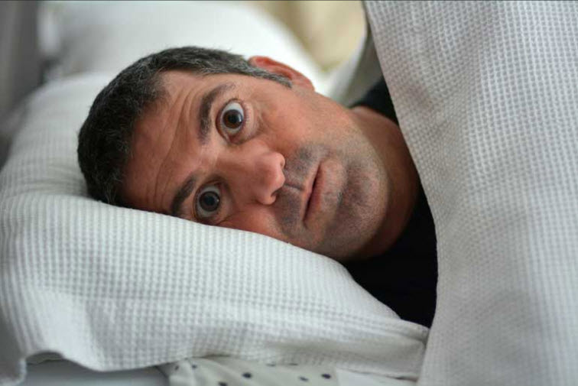
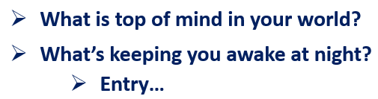
Thursday, October 30, 2025
Facilitating Effective Tabletop Exercises
Getting Engaged:
I always start with a Threats Discussion –
  Frequent power outages / colder weather (snow and ice)
  Cyber threats – Ransomware, Social Engineering,
  Phishing, Smishing
  Losing key employees – attracting/retaining talent
  Regulatory concerns/testing
  Internal Fraud

Slide 6




Thursday, October 30, 2025
Facilitating Effective Tabletop Exercises
Types of Scenarios:
Facility
Systems
People
Cyber

Slide 7
Thursday, October 30, 2025
Facilitating Effective Tabletop Exercises
1
Scenario

Slide 8
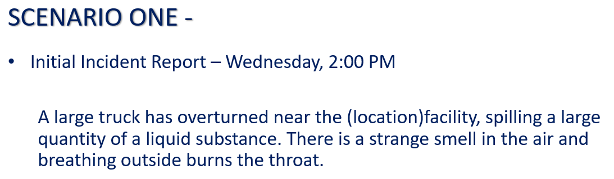
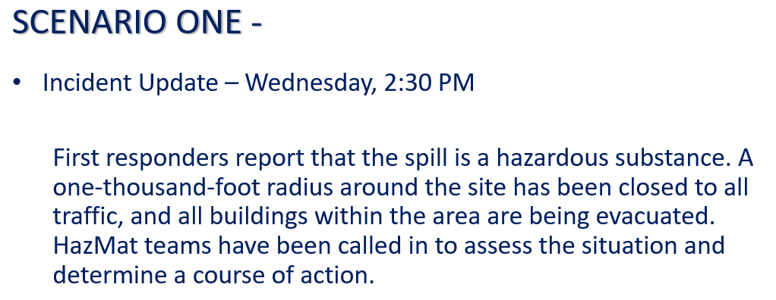
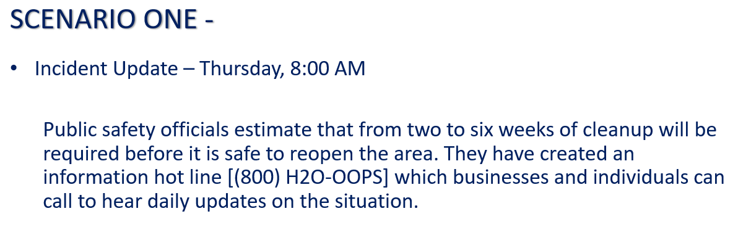
Thursday, October 30, 2025
Facilitating Effective Tabletop Exercises
It’s a Trap!:
Each scenario is presented as a developing crisis…
  Initial Event
  Event Update
  Event Update
To simulate a real event
You don’t have all the information at once
Initial decisions may create complications as new elements introduced

Slide 9
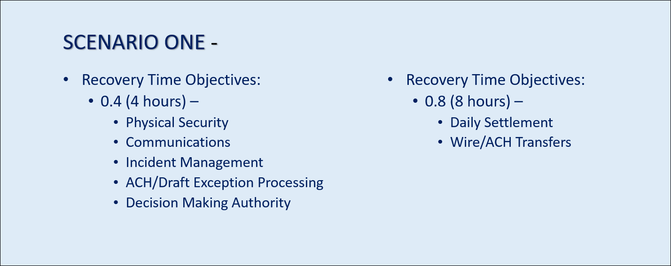
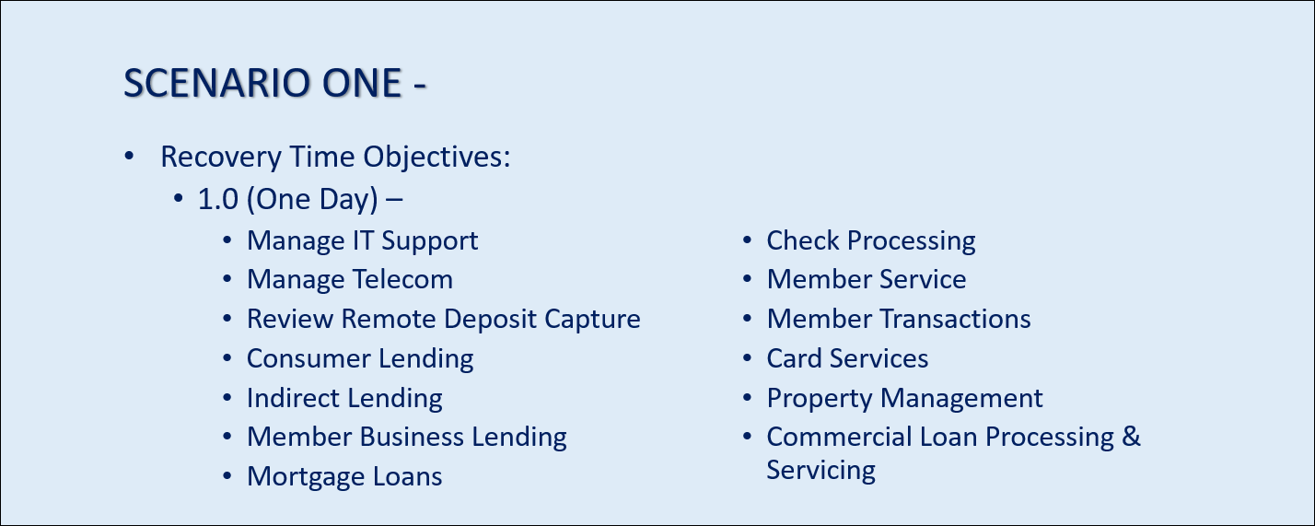
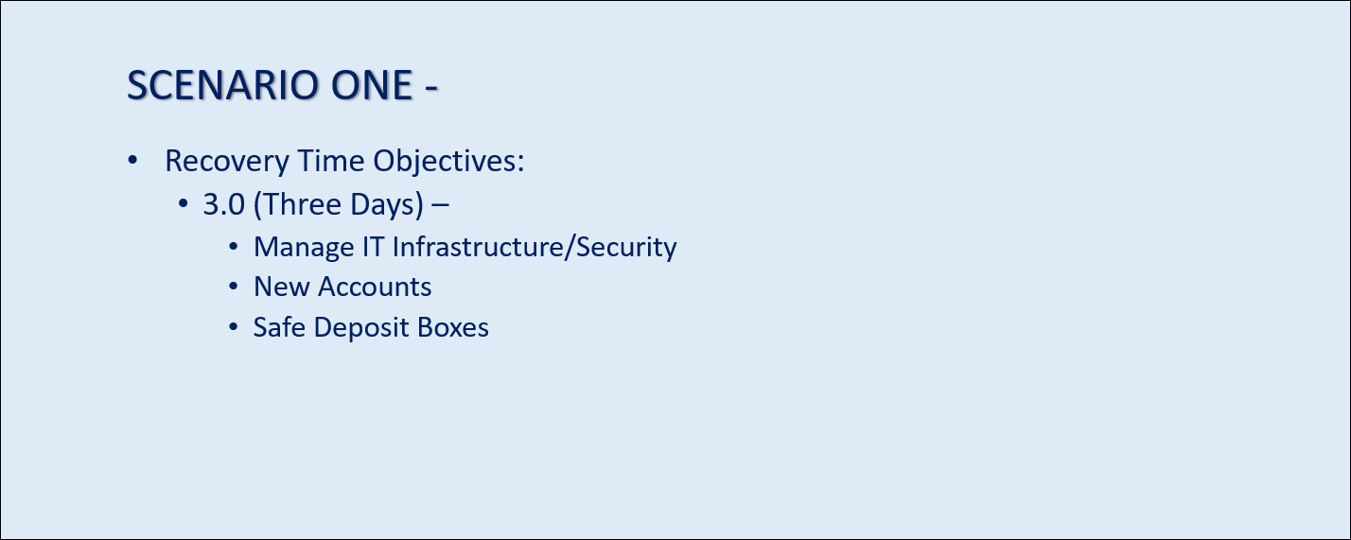
Thursday, October 30, 2025
Facilitating Effective Tabletop Exercises
It’s a Trap!:
Tie things back to business processes
When practical, coincide with each new update
Review the processes to see which ones are impacted by the event
  In the scenario example, it’s 2:00 PM
  ACH/Draft Exception Processing ✓
  Daily Settlement ✓
  Wires/ACH Transfers ✓

Slide 10
Thursday, October 30, 2025
Facilitating Effective Tabletop Exercises
It’s a Trap!:
Response
  As each new element is introduced, participants can respond with actions
  As needed, ask questions to help them think things through
    Shelter in place
    Call 911
    Clear the area – this could be difficult
    Shut down HVAC
    Put tape/plastics/anything around gaps under doors
    Notify staff/managers
    Put signs up and close the doors

Slide 11
Thursday, October 30, 2025
Facilitating Effective Tabletop Exercises
It’s a Trap!:
Response
  As each new element is introduced, participants can respond with actions
  As needed, ask questions to help them think things through
    Check to see if anyone needs medical treatment due to the smell/burning throats, etc.
    Where is our first aid kit? Water, eye washing options, etc.
    Turn on a radio or television or check the web for news

Slide 12
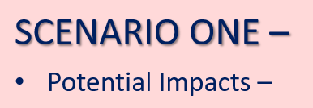
Thursday, October 30, 2025
Facilitating Effective Tabletop Exercises
It’s a Trap!:
Additional information (optional, if warranted, based on scenario)
  Impacts –
    Medical crisis
    How to shelter in place
    How to seal gaps
    What to do with members on site?
    Notification to staff, families, etc.

Slide 13
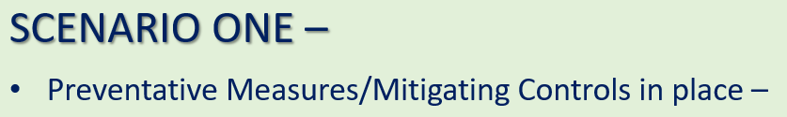
Thursday, October 30, 2025
Facilitating Effective Tabletop Exercises
It’s a Trap!:
Additional information (optional, if warranted, based on scenario)
  Preventative Measures/Mitigating controls in place –
    Shelter in place plan
    First aid kit
    Duct tape and plastic sheeting
    If, what do we have
    Employees that are trained on initial emergency procedures

Slide 14
Thursday, October 30, 2025
Facilitating Effective Tabletop Exercises
It’s a Trap!:
Response
    Find food and water!
    Establish contact with first responders
    Since it looks like we’ll be closing for a bit, start getting ready, balance cash drawers, checks, etc.
    Remain aware of any medical issues that may develop while we are waiting
    Put messaging out – website, digital banking, social media, email blast etc. to alert members and staff to stay clear.
    Alert vendors – cleaners, system vendors, salespeople or members that have appointments.

Slide 15
Thursday, October 30, 2025
Facilitating Effective Tabletop Exercises
It’s a Trap!:
Response
    If we have a reciprocal location – reach out
    in case we need to use it.
    If you have multiple locations, alert other sites to expect more traffic, phone calls, questions, etc.

Slide 16
Thursday, October 30, 2025
Facilitating Effective Tabletop Exercises
It’s a Trap!:
Response
    Declare disaster and activate Business
    Continuity Plans
    Determine where people will be needed and how to support members and operations during the closure of the impacted location.
    Contact State DIFS/NCUA – why? Catastrophic Act Reporting – closed for more than two days, need to notify regional NCUA director within 5 days,
    Update members on alternate locations/delivery channels
    Determine supplies and supporting resources needed to support operations Cash?
    Notify alarm company.

Slide 17
Thursday, October 30, 2025
Facilitating Effective Tabletop Exercises
It’s a Trap!:
Response
    Once we have everything – did we miss
    something? Check Incident Management, Emergency Procedures, Business Continuity Plan documentation – did we cover anything? Was there things we needed that we did NOT have? What might we have done differently.

Slide 18
Thursday, October 30, 2025
Facilitating Effective Tabletop Exercises
2
Scenario

Slide 19
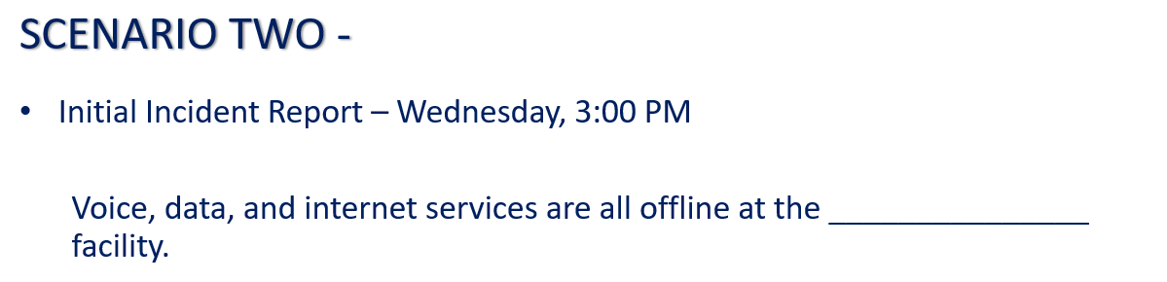
Thursday, October 30, 2025
Facilitating Effective Tabletop Exercises
A Second Scenario:
Impacts
    Anything internet dependent is offline:
      Access to core system
      Credit reporting
      Digital/online banking
      Shared branching
      Call center down (VoIP)
      Loan approvals
      New accounts – can’t check OFAC

Slide 20
Thursday, October 30, 2025
Facilitating Effective Tabletop Exercises
A Second Scenario:
Initial Response
    Institute offline procedures
    Contact IT to see if they know what happened
    Contact ISP to say hey – what happened?
    Notify staff, management, other locations, members of impact, signage, could also be that is down at the moment when asked
    Contact alarm company (we use internet, cell, and radio network, plus a copper line), backup POTS line and cell service options (Grace)

Slide 21
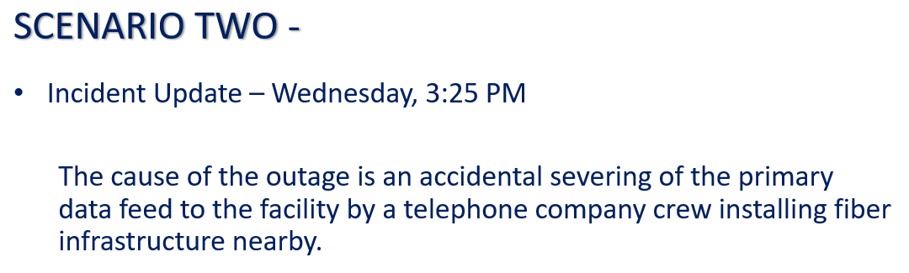
Thursday, October 30, 2025
Facilitating Effective Tabletop Exercises
A Second Scenario:
Does this update change anything? Maybe not
Response
    Line cut are typically repaired pretty quickly – hours not days
    3:25, we might simply continue in offline mode and see what happens?
    Get an update from the ISP on how long they expect repairs to take

Slide 22
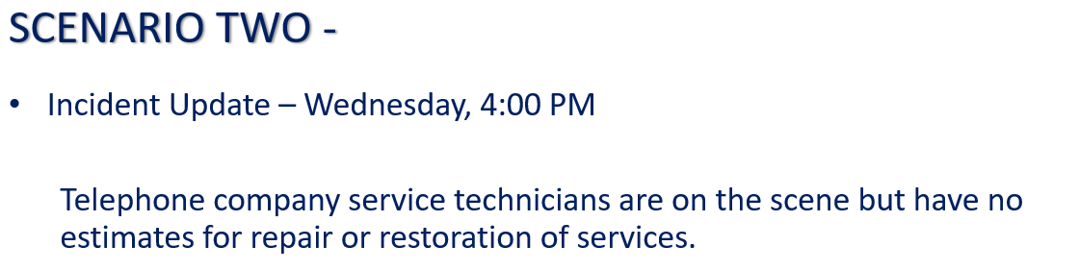
Thursday, October 30, 2025
Facilitating Effective Tabletop Exercises
A Second Scenario:
Response
    Wait (patiently…)
    Use manual closing procedures if this continues to closing time.
    Discuss options/plans for what to do tomorrow if this is not fixed overnight.

Slide 23
Thursday, October 30, 2025
Facilitating Effective Tabletop Exercises
3
Scenario

Slide 24
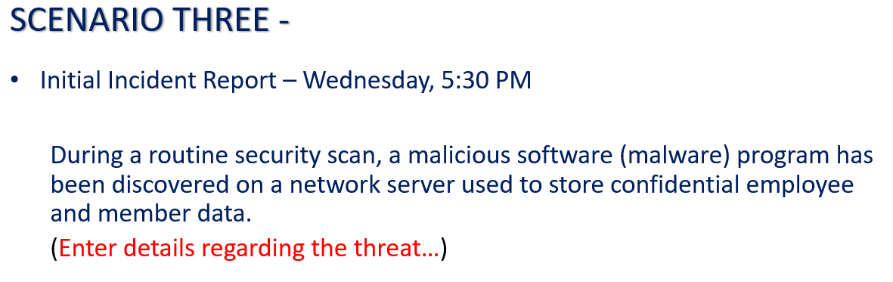
Thursday, October 30, 2025
Facilitating Effective Tabletop Exercises
A Third Scenario:
About those Details…
    Questions:
    Do we have a shared network file server? Yes
    Is it likely that there is employee and member data on it? Yes
    How many members total? 8,432
    How many members may have data on that server on any given day? 10% to 100%

Slide 25
Thursday, October 30, 2025
Facilitating Effective Tabletop Exercises
A Third Scenario:
Initial Response
    Entry…

Slide 26
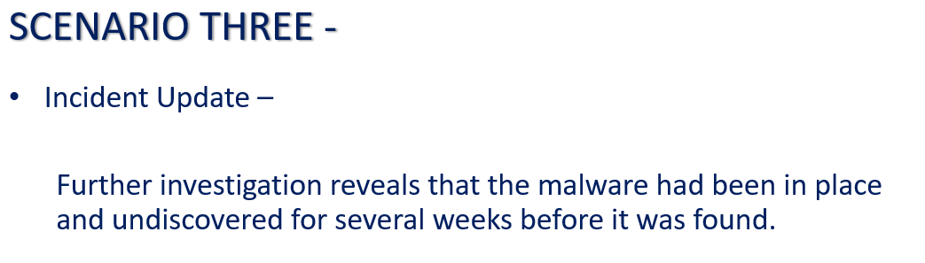
Thursday, October 30, 2025
Facilitating Effective Tabletop Exercises
A Third Scenario:
Response
    Entry…

Slide 27
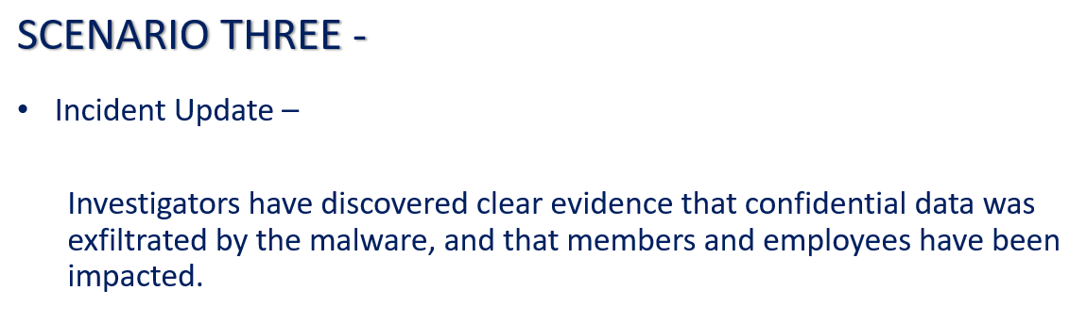
Thursday, October 30, 2025
Facilitating Effective Tabletop Exercises
A Third Scenario:
Response
    Entry…

Slide 28
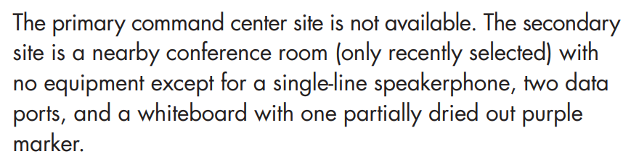

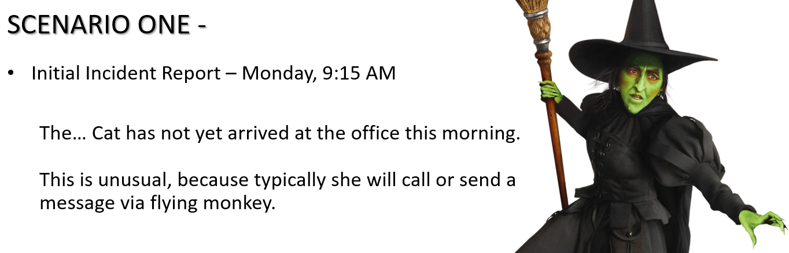


Thursday, October 30, 2025
Facilitating Effective Tabletop Exercises
Tinkerbelle would be Proud:
Sprinkle enough fairy dust (details) to put them in the scenario
Or use it to make a difficult topic easier to contemplate

Slide 29

Thursday, October 30, 2025
Facilitating Effective Tabletop Exercises
Mixing Things Up:
Adding the element of chance…
  Dice rolls to determine the outcome of a particular element
    Roll two dice. If the number rolled is odd, X happens, if even, Y happens
  Pick (or deal) a card(s)
    If you are got a red card, you feel ill
  Select a number from 1 to 100
  Flip a coin
  Look under your seat

Slide 30
Thursday, October 30, 2025
Facilitating Effective Tabletop Exercises
What’s Next:
I close each session with discussion items, Q&A, follow up activities
Discussion and Q&A
  Am I for hire? Yes?
  Have we done this for all staff? Yes
  Where are you located? Maine – Currently I am in PA

Slide 31

Thursday, October 30, 2025
Facilitating Effective Tabletop Exercises
Contact information:
Bill Ashland
AVP, Business Continuity
Synergent
washland@synergentcorp.com

